Slide 1
Lessons Learnt from Last Year
By SUDA (Health)

Slide 2
Vector Control Team (VCT)
Number of teams not in place as per requirement
Same members employed as regular conservancy and VCT
Frequent change in the team composition
Not properly trained about dose and frequency of Larvicidal & proper use of Knapsack/Fogging Machine
Timing of VCT and HTH team members not at par with each other which is required for their convergence.

Slide 3
House To House Team (HTH)
Proper coordination with VCT members is lacking
Under reporting in few areas - specially Larvae identification & Fever incidence
Frequent change in the team members leading to few untrained ones being employed for the work
Difficulty faced by the female members to reach the inaccessible areas of the community

Slide 4
Portal entry
Issue with daily portal entry has been found among few ULBs
Link failure responsible most of the times
Partial reporting due to failure to upload details from all the teams
Environmental Management portal was not updated regularly by the ULBs

Slide 5
Solid Waste Management
Garbage cleaning inadequate in most of the area specially along banks of water bodies and abandoned lands
Door to door collection not monitored properly
VAT placement at important sites requested by few ULBs
Dumping ground –
- Absent in few ULBs due to lack of proper available land
- Overflowing, resulting in huge heaps of waste leading to community grievance
- Further management of the collected solid waste was inadequate in most ULBs

Slide 6
Drains
Clogged or Partially blocked drains in most ULBs
Major source of Larvae mainly during the lean /dry periods of the year
De-silting of drains not being done regularly at most of the ULBs specially for household drains
Covers over most of the drains are absent/broken, leading to easy access for mosquito breeding

Slide 7
Reporting by ULBs in prescribed formats
Action taken report
Dengue Case Surveillance
Fever surveillance
Environmental management

Slide 8
District wise Glimpses of 13 rounds of h-t-h (july to dec’2018)

Slide 9
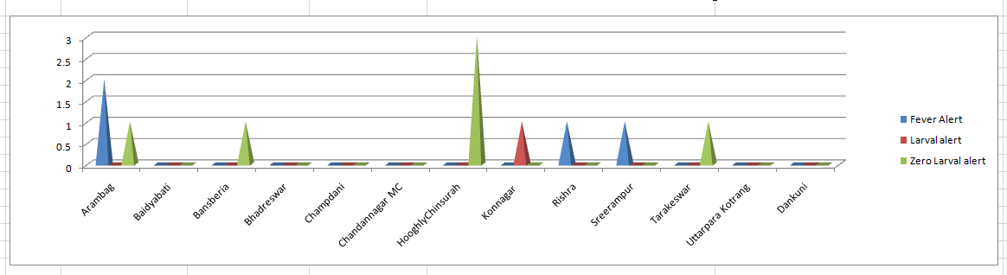
hooghly

Slide 10
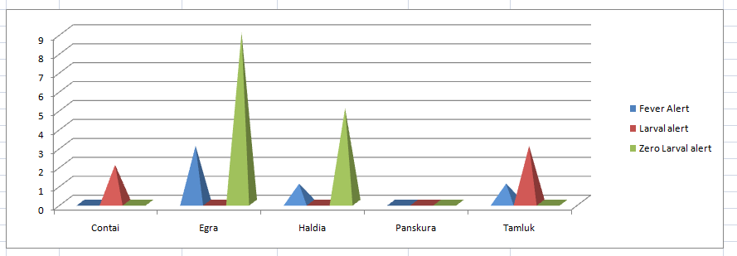
Medinipur (E)

Slide 11
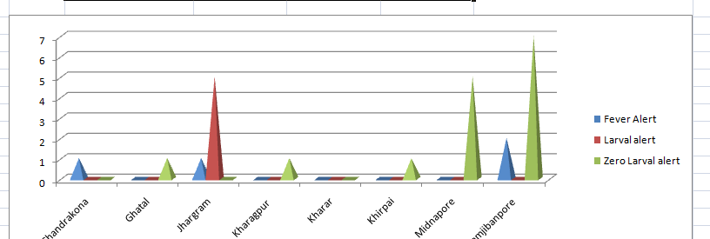
Medinipur (W)

Slide 12
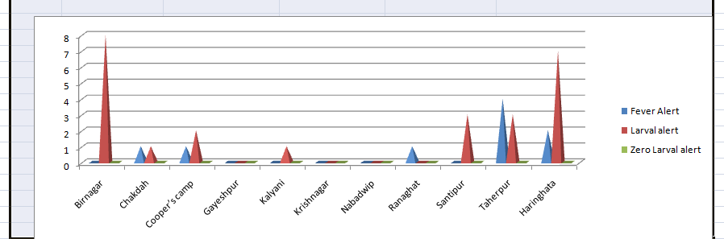
nadia

Slide 13
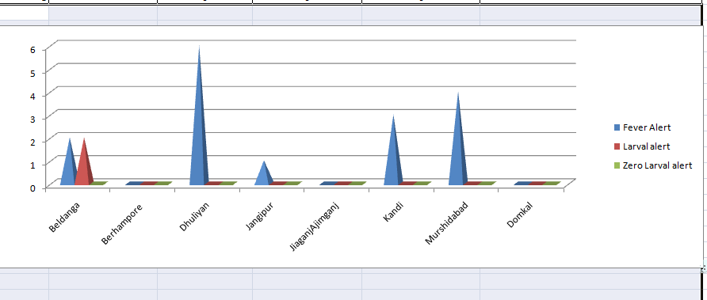
murshidabad

Slide 14
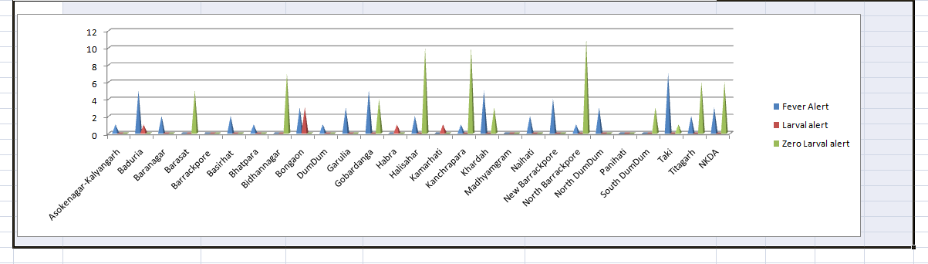
North 24 parganas

Slide 15
THANK YOU
From Team SUDA

