Slide 1
Epidemiology of Dengue
Dr. Debjit Chakraborty
CPHO, SUDA
22/02/2019 & 01/03/2019

Slide 2
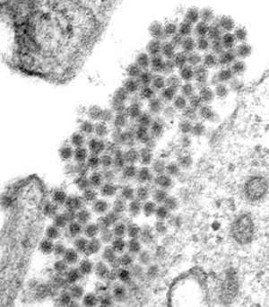
What is Dengue
Dengue (pronounced den’gee) is a viral disease.
Dengue can be caused by infections with any one of four closely related dengue viruses.
DENV 1, DENV 2, DENV 3 or DENV 4

Slide 3
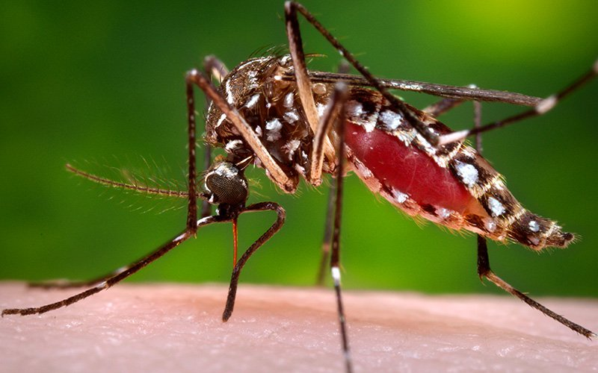
How does it spread
The dengue viruses are transmitted to humans by the bite of an infected Aedes mosquito.

Slide 4
Basic Facts
Period of Communicability – first 4-5 days
Reservoir: case (subclinical ?)
Age: more among young children & adults, no preference
Sex: Male> Female for exposure to bite
Immunity: One attack – type specific immunity for 9 months and Partial Cross Immunity. Several attack with same serotype confers lifelong immunity

Slide 5
Transmission
Modes of transmission: bite of infected female Aedes mosquito
Aedes egypti – urban, Aedes albopictus – rural
Transovarian transmission, Propagative
Extrinsic Incubation Period : 8 -10 days
Intrinsic Incubation Period : 5-10 days
Serial Interval – 13 -20 days
Velocity of Epidemic – Ratio of cases between later and earlier serial interval > 1 (e.g. 40/20 =2)

Slide 6
Clinical Spectrum (1/2)
Asymptomatic Dengue Viral Infection
Undifferentiated Viral fever – mild prodrome, no classical feature, complete recovery in few days
Classical Dengue Fever –high fever, biphasic(saddle back), myalagia, arthralgia,leukopenia, complete recovery in 8-10 days, CFR low

Slide 7
Clinical Spectrum (2/2)
Dengue Fever with unusual Hemorrhage- classical DF + unusual bleeding (Petechiae etc), increased capillary fragility
Dengue Hemorrhagic Fever without Shock – severe form, result of two sequential infection (type I / II and type III/ IV), immune mediated, critical period – 6 months between two infection
Dengue Hemorrhagic Fever with Shock (DSS)- very severe form, 30% of all DHF, on 2nd or 5th day patient deteriorates suddenly and rapidly, Acute Abdominal Pain may occur, Death in 12- 24 hours

Slide 8
Warning signs
Immediate medical attention !
Severe abdominal pain or persistent vomiting
Red spots or patches on the skin
Bleeding from nose or gums
Vomiting blood
Black, tarry stools (faeces, excrement)
Drowsiness or irritability
Pale, cold or clammy skin
Difficulty in breathing

Slide 9
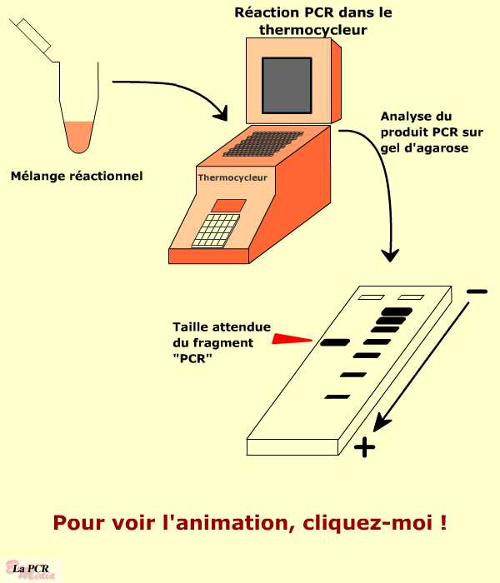
Diagnostic tests
Virus isolation by infection of mice using infected mosquitoes
Detection of IgM antibodies in the blood by PCR or Viral isolation (Serology)
ELISA (Enzyme-Linked Immunoabsorbent assay)
Thrombopenia
Raised hematocrit

Slide 10
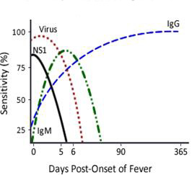
Dengue specific tests
Dengue specific tests done in a blood sample can confirm a diagnosis of dengue.
There are two basic types of tests:
Detecting dengue antigen in blood (within first 5 days of onset of symptoms): NS1 antigen based assays
Detecting dengue antibodies in blood (after first 5 days of onset of symptoms)

Slide 11
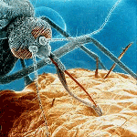
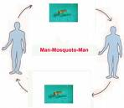
Pathogenesis and infection process of Dengue
Humans are initially infected through a mosquito vector
Initial interaction with cell occurs with the viruses ability to infect cell
  Primary target, Phagocytes
Virus uses cell receptor molecule to enter cell
Cell receptor molecules include:
  Glycosaminoglycan
  Heparan Sulfate (Expressed in almost all cell types)
Virus replicates in target organs
Infects white blood cells and lymphatic tissues
Virus is released and circulates in blood
Alternate mosquito then bites host and receives virus

Slide 12
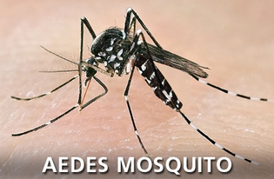
Characteristics of the Aedes Mosquito
One distinct physical feature (black and white stripes on its body and legs). Hence also called as “Tiger Mosquito”.
Bites during the day.
Lays its eggs in clean, stagnant water

Slide 13
Aedes mosquito : Fast facts
Only the female Aedes mosquito bites as it needs the protein in blood to develop its eggs.
The mosquito becomes infective approximately seven days after it has bitten a person carrying the virus.
Once infected, a mosquito remains infective for life and passes on the virus to the eggs it lays.
Peak biting time is at dawn and dusk – 2 hours after sunrise and 2 hours before sunset.

Slide 14
Aedes mosquito : Fast facts (contd.)
The average lifespan of an Aedes mosquito is 2 weeks.
The mosquito can lay eggs about 3 times in its lifetime, and about 100 eggs are produced each time.
The eggs can withstand very dry conditions (desiccation) and remain viable for many months in the absence of water
Repopulation will occur as soon as the eggs in the containers are flooded with water.
Mostly breeding occurs in stagnant collection of water how small the amount may be

Slide 15
Aedes mosquito : Fast facts (contd.)
Adult mosquitoes “usually” rests indoors in dark areas (closets, under beds, behind curtains).
They have limited range – can fly an average of 400 metres looking for water-filled containers to lay their eggs. This means that people, rather than mosquitoes, rapidly move the virus within and between communities and places.
A few mosquitoes per household can produce large dengue outbreaks. The dengue mosquito usually does not lay eggs in ditches, drainages, canals, wetlands, rivers or lakes where flow exists.

Slide 16
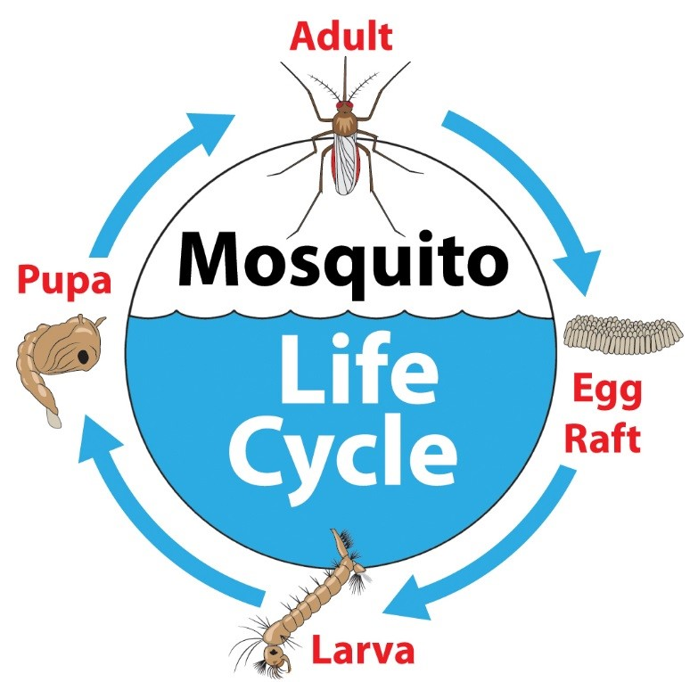
Aedes mosquito : Fast facts (contd.)
The mosquito life cycle, from egg to larvae, pupae and to an adult mosquito takes 8 days and occurs in water.
Humans develops disease after 5 – 6 days of being bitten by an infective mosquito.

Slide 17
Aedes related indices
House Index – no of houses with larva/no of house inspected *100
Container Index - no of containers with larva/no of containers inspected *100
Breteau Index – no of positive containers /no of house inspected *100
Pupae Index – same as HI with pupae

Slide 18
Prevention Strategy
Elimination of reservoir – putting cases in mosquito net for first 5 days, no other role
Breaking the chain of transmission – Antilarval measures mainly. Sometimes Antiadult measures in case of Outbreak . Also Environment Management, Source reduction (aimed at larva destruction)
Protection of Susceptible – personal protection, nets, clothing etc

Slide 19


