Slide 1
DENGUE –A Overview

Slide 2
SCENARIO
GLOBAL SCENARIO- Although the full global burden of this disease is uncertain, every year hundred of thousand cases arises, among them 20000 lead to death. The loss of economy is 264 DALYs/million/yrs.
NATIONAL SCENARIO- the first case of dengue in India was detected from Vellore district, Tamil Nadu. The first DHF outbreak at Calcutta(West Bengal) occurred in 1963.
Among all except Lakshadweep state have reported dengue cases in last two decade.

Slide 3
EPIDEMIOLOGY
Dengue is a mosquito borne viral disease.
It has shown to increase in some particular condition like-
-deficient water management
-improper water storage.
-stagnation of rain water.
-proliferation of vector breeding site.
the epidemiology of dengue virus depends upon a complex epidemiological factor, viz. host(man and mosquito), agent (virus), the environment (biotic and abiotic).

Slide 4
Contd.
During inter epidemic period the transmission remain low because of extremes of temperature and low relative humidity.
But during monsoons the environment become suitable for vector. The temperature range of 25 , relative humidity around 80% and innumerable small water collection result in high vector density.

Slide 5
Dengue Virus
Dengue virus are categorized under genus flavivirus.
These virus contain single stranded RNA and small in size (50 nm).
There are four serotype, designated as DENV-1, DENV-2, DENV-3 and DENV-4.
These serotype may be remain in circulation singly or more than one can be present at the same time.
Although all the serotype antigenic ally similar, but they may elicit cross protection but for a short period.
Infection with any one serotype confers lifelong immunity to that virus serotype.

Slide 6
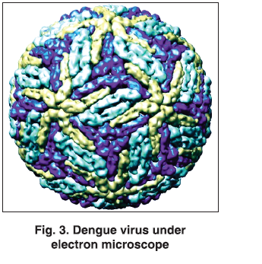
Dengue virus

Slide 7
Molecular epidemiology
The four dengue virus serotype form a phylogenetic group and differ in nucleotide sequence from each other.
The following genotype or subtype were detected within each serotype based on their phylogenetic analysis of genomic region in the envelope gene.
-DENV-1:three.
-DENV-2:two( one non-human primate)
-DENV-3:four
-DENV-4:four(one non-human primate)

Slide 8
Contd..
The dengue virus genome is composed of three structural protein gene encoding,
-nucleocapsid core protein.
-a membrane associated protein.
-an envelope protein.
Seven non structural (NS) protein, viz. NS1, NS2A, NS2B, NS3, NS4A, NS4B and NS5.
However NS1 has been shown to interact with host immune system and known to evoke T cell response.
In dengue virus infection patients have measurable level of NS1 protein, which are utilized as a diagnostic marker of infection.

Slide 9
vector
Dengue virus are transmitted from an infected person to other by the bite of female Aedes (Ae.) mosquito.
In India Ae. aegypti is the main vector in urban area. However Ae. Albopictus also incriminated in many states.

Slide 10
Pathology behind clinical feature
Immuno- pathogenesis
Various mechanism are proposed to explain signs and symptoms such as,
-complex immune mechanism.
-T cell mediated antibodies cross reactivity with vascular endothelium.
-enhancing antibody ,complement and its product.
-Various soluble mediator including cytokines and chemokine's.

Slide 11
Contd….(pathology)
The most favoured are virus strains enhancing antibodies and memory T cell in a secondary infection resulting ‘’cytokine tsunami’’.
Whatever the mechanism are, these ultimately target vascular endothelium, platelets and various organ.
These ultimately lead to vasculopathy and coagulopathy for the development of DHF/shock.

Slide 12
Capillary leakage and shock
Anti NS1 antibody act as a autoantibodies that cross react with platelets and non infectious endothelial cell which trigger the intracellular signaling leading to disturbance in capillary permeability.
Plasma leakage is caused by diffuse increase in capillary permeability and manifest as any combination of haemoconcentration, pleural effusion or ascites.
It usually become evident 3rd to 7th day of illness and patients may be afebrile during this period.

Slide 13
Coagulopathy in dengue
Release of heparin sulphate or chondroitin sulphate (molecule similar in structure to heparin that can mimic in funtion as an anticoagulant) from the glycocalyx contribute to coagulopathy.
An increase in activated partial thromboplastin time (aPTT) and reduction in fibrinogen concentration are fairly consistent findings.

Slide 14
Causes of bleeding in DF/DHF
Thrombocytopenia
Platelets dysfunction
Endothelial injury.
Decreased fibrinogen
Prothrombin complex deficiency.
Secondary liver involvement.
Activation of mononuclear phagocytes.

Slide 17
Undifferentiated dengue fever(UDF)
In primary dengue infection patient may develop only mild to moderate fever and it is often difficult to distinguish from other viral infection.
Maculopapular rash may or may not be appear during fever or defervescence.
The symptomps of DF may not be very distinguished and signs of bleeding or capillary leakage may be absent.

Slide 18
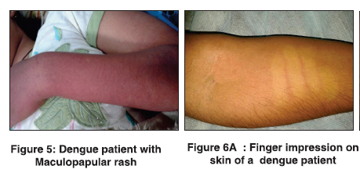

Slide 19
Warning signs and symptoms
The following signs and symptomps are indicator of disease progression and severity of DF/DHF/DSS.
Recurrent vomiting.
Minor bleeding from different site.
Abdominal pain/discomfort
breathlessness
Decrease urine output
High Hct ( >45%)
Hypotension
Narrow pulse pressure
Cold clammy extremities
Rapid fall in platelet count
Pleural effusion
Ascites

Slide 20
High risk group
The following high risk group may have severe manifestation or complication with DF/DHF. Therefore these group of patients should be closely monitored.
Pregnancy
Elderly
Infants
Peptic ulcer disease
Hypertension
Pt is on anticoagulants, steroid, antiplatelet.
immunocompromised

Slide 21
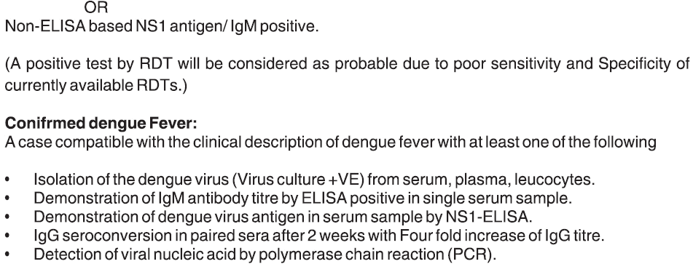
Case definition
Probable DF/DHF:
A case compatible with clinical description of dengue fever during outbreak,

Slide 22
‘’Severe’’ dengue fever
Based on thrombocyte count , hematocrit, capillary leakage, bleeding and hypotension DHF has been divided into four grade.
Severe dengue may be DHF grade 3 or 4 with or without bleeding.
DHF grade 1 or 2 may be severe when presented with significant bleeding or metabolic and electrolyte abnormalities.
During illness following organ involvement indicate high morbidity and mortality,
-hepatic
-renal
-cardiac
-pulmonary
-CNS

Slide 23
Clinical criteria
Clinical features of DF
An acute febrile illness of 2-7 days duration with two or more of the following manifestation:
-headache
-retro-orbital pain
-myalgia
-arthralgia
-rash
-hemorrhagic manifestation .

Slide 24
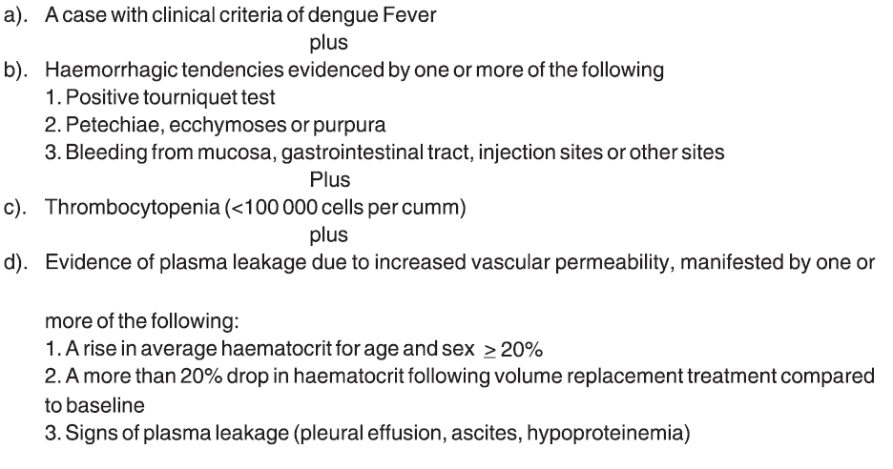
Dengue haemorrhagic fever(DHF)

Slide 25
Dengue shock syndrome (DSS)
All the above criteria for DHF with features of circulatory failure evidenced by:
-rapid and weak pulse.
-narrow pulse pressure (<20 mm of Hg)
-hypotension
-cold and clammy skin
-restlessness.

Slide 26
Natural course of dengue infection
The clinical course of illness passes through the following three phase:
Febrile phase
Critical phase
Convalescent phase

Slide 27
FEBRILE PHASE:
The onset of dengue fever is usually sudden rise of temperature which may be biphasic.
It usually last for 2-7 days.
Commonly associated with headache, flushing and rash.
Unusual hemorrhagic manifestation may be seen rarely in case with co-morbid illness.

Slide 28
Critical phase(leakage phase)
DF/DHF usually go through critical phase after 3 to 4 days of onset of fever.
Plasma leakage and high haemoconcentration are documented and patients may develop hypotension.
Abnormal haemostasis and leakage of plasma lead to shock, bleeding, fluid accumulation in pleural and abdominal cavity.
Usually persist for 36-48 Hrs.

Slide 29
Convalescent phase(recovery phase)
During the recovery phase the ECF which was lost due to plasma leakage return back to circulatory system.
Usually occurs after 6-7 days of fever and last for 2-3 days.
In this phase signs and symptomps improve.
Organ involvement may prolong the recovery phase.

Slide 30
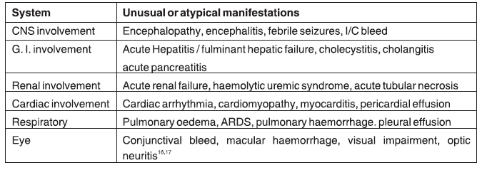
Expanded dengue syndrome (EDS)
Unusual manifestation of DF/DHF are commonly associated with co-morbidities and with various other co- infection. Clinical manifestation of EDS are as follows.

Slide 31


Slide 32
Laboratory diagnosis
Laboratory diagnosis can be carried out by one or more of the following test,
ELISA based NS1 antigen test.
IgM –capture enzyme linked immunosorbent assay (MAC-ELISA)Isolation of dengue virus.
Polymerase chain reaction (PCR).
IgG-ELISA.
Other serological test, eg complement fixation (CF), neutralisation test(NT)

Slide 33

Investigation for indoor patient
- CBC with hematocrit.

Slide 34
Clinical management
Management of dengue fever may vary depending upon the severity of illness.
The patient who have simple fever without any complication or danger sign can be managed with symptomatic approach.
Those having warning signs and symptomps should be closely monitored for progression of disease.
Patient with grade 3 /4 DHF ,bleeding, organ involvement require aggressive management.
Patients may develop complication during later phase of fever (defervescence) or afebrile phage, hence clinician should be careful to look for any danger signs .
During aggressive management , clinician should be concerned about volume overload also.

Slide 35
Management during febrile phase
Paracetamol is recommended to keep temperature below 39 c.
Adequate fluid should be advised to the extent patients can tolerate. e.g- ORS, fruit juice, plain water.
Intravenous fluid should be administered if the patient vomiting persistently or refuse to feed.
Patients should be closely monitored for initial sign of shock.

Slide 36
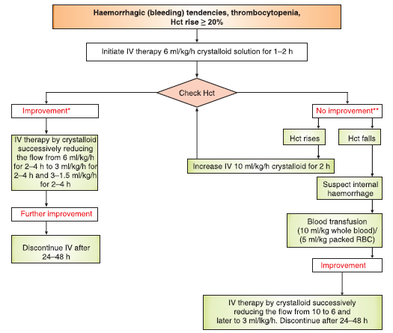
Management (DHF grade 1/2)

Slide 37
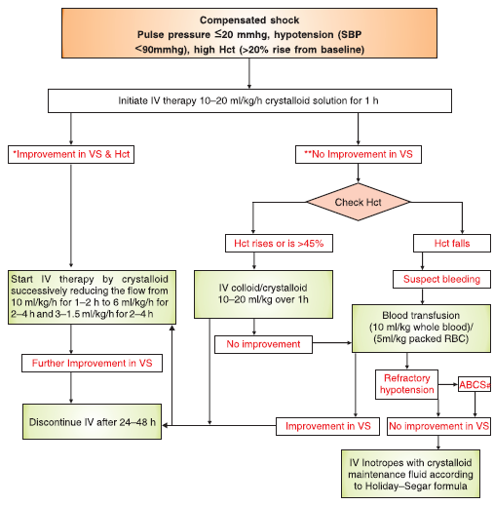
Management (DHF grade 3)

Slide 38
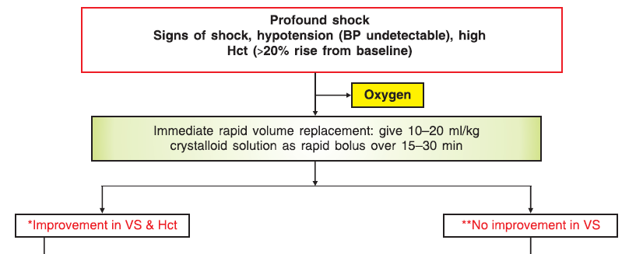
Management (DHF grade 4/DSS)

Slide 39
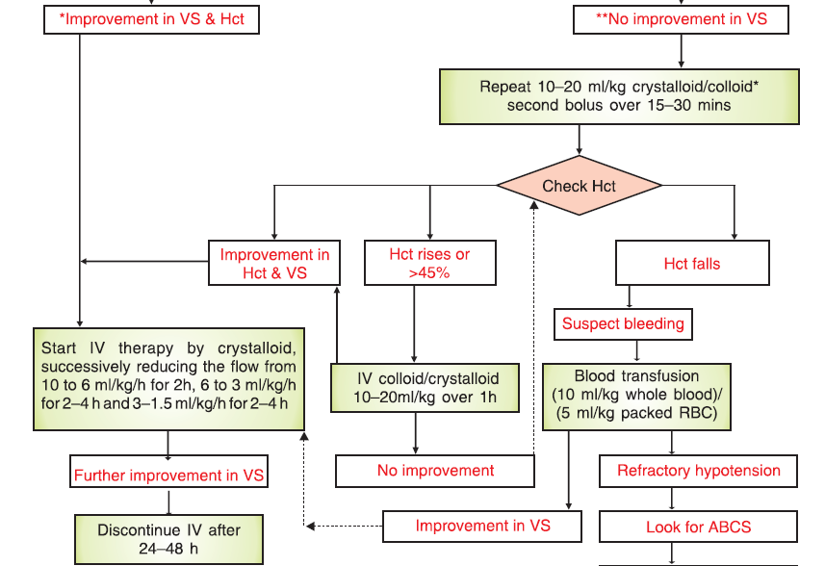
contd….

Slide 40
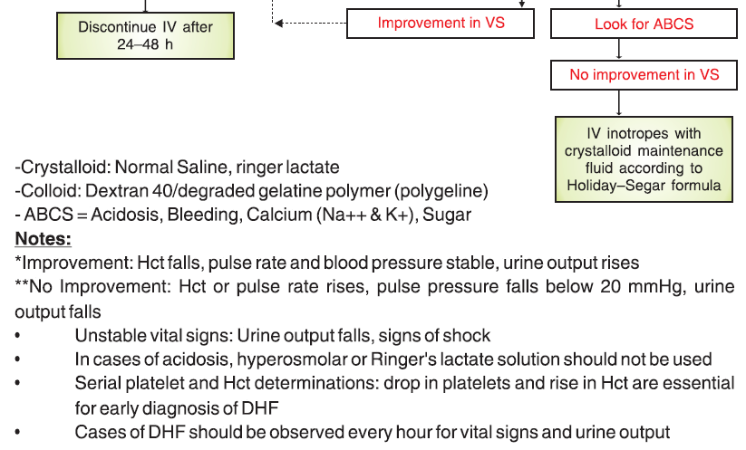
Contd….

Slide 41
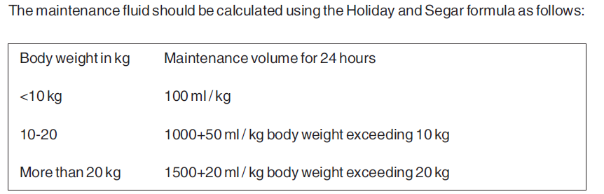
Calculation of fluid
Amount of fluid to be given in 24 hrs is calculated by adding maintenance +5% dehydration, which is equivalent to 50ml/kg.
These should be given to maintain just intravascular volume and circulation.

Slide 42
Intravenous fluid for resuscitation
There is no clear advantages of colloid over crystalloid in term of overall outcome.
However colloid is preferred choice if the blood pressure has to be restored quickly.
Colloid have been shown to restore cardiac index and reduces the hematocrit level faster than crystalloid in patients with intractable shock and pulse pressure less than 10 mm hg.

Slide 43
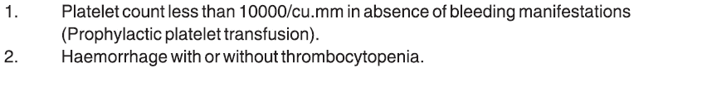
Indication of platelet transfusion

Slide 44
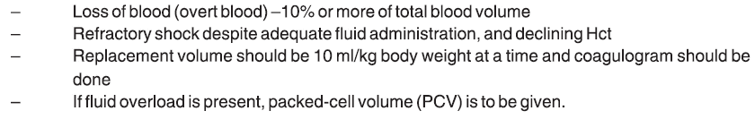
Indication of blood transfusion

Slide 45
Dengue viral hepatitis
Hepatic involvement is commonly associated with pre-existing condition like chronic viral hepatitis, cirrhosis of liver or liver disease due to other cause.
Patients may develop HE, GI bleed, DSS, mild impairment of liver function.
Managed with hepatic failure regimen, fluid and blood transfusion.
If PT is prolonged IV vitamin K1 may be given.

Slide 46
Dengue myocarditis
Dengue infection may rarely causes myocarditis.
May be seen in presence of CAD, HTn, DM, valvular heart disease.
Patients may develop pulmonary edema due to improper fluid management.
In shock stage, it is difficult to manage because of myocardial dysfuntion.
Patient may develop CCF and should be managed accordingly.

Slide 47
DF in Diabetes
Sometimes patients may develop severe complication when target organ are involved like vasculopathy, cardiomyopathy, HTn, nephropathy.
Blood sugar may become uncontrolled and sometimes insulin may require for better controll.

Slide 48
Renal involvement in dengue fever
ATN may develop in DSS and may complicate AKI if fluid therapy is not initiated in time.
Urine output monitoring is very important to assess renal important.
Fluid intake should be closely monitored in case of AKI to avoid fluid overload and pulmonary edema.
Patient may develop DHF in presence of diabetic nephropathy, hypertensive nephropathy or pre existing renal disease.

Slide 49
CNS involvement in DF
Altered sensorium may develop in dengue patients due to,
-shock (DSS)
-electrolyte imbalance.
-hypoglycemia
-fluid overload.
Acute encephalopathy or encephalitis may be seen. Here dengue IgM in CSF can help to conform the diagnosis.

Slide 50
DF with co infection
DF with TB
Patient may develop breathlessness, hemoptysis, pleural effusion, ARDS.
If patient is already on ATT, then should be closely monitored for development of such complication.

Slide 51
DF in HIV
Outcome of DF in AIDS patients is poor among patients having opportunistic infection and low CD4 count.
Multi organ failure is common and therefore high mortality.
Management should be undertaken with HIV specialist consultation.

Slide 52
DF with malaria
Malaria should be excluded in the beginning as it has specific management.
Antimalarial treatment should be started as soon as possible to prevent complication.

Slide 53
Management of dengue in pregnancy
DF in pregnancy carries the risk of more bleeding, LBW and premature outcome.
Pleural effusion, ascites, hypotension are commonly associated.
Pregnancy is a state of hyper dynamic circulation, so fluid therapy should be carefully done.
Frequent platelet count, coagulation testing, regular BP and urine output monitoring should be performed during DF in pregnancy.

Slide 54
Vaccine in dengue infection
Till now no licensed vaccine available for dengue vaccine.
Several trial are ongoing in the world for the development of tetravalent dengue vaccine.
So far phase 3 trial of a recombinant live attenuated tetravalent dengue vaccine has completed in five Asian countries in children.

Slide 55
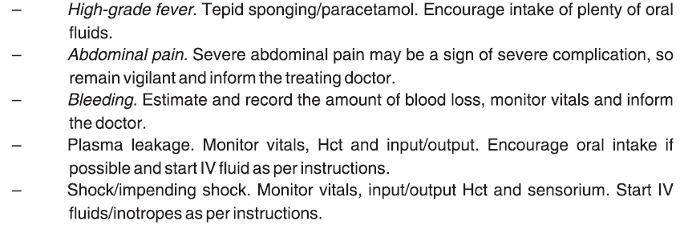

Slide 56
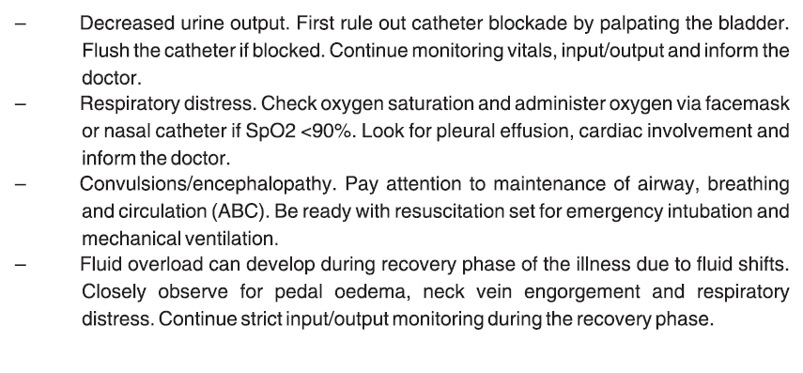
Contd…..

Slide 57
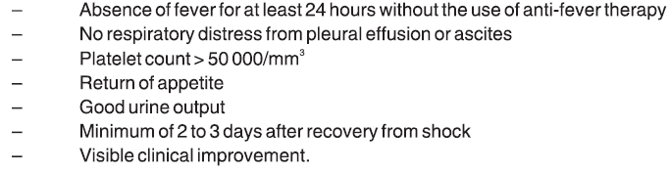
Criteria for discharge of patients

Slide 58
THANK YOU

